Slide 1
Wordstat Prototype of Comcast Complaints Data for Predicting Customer Churn
John Aaron
Elmhurst College
MDS 560

Slide 2
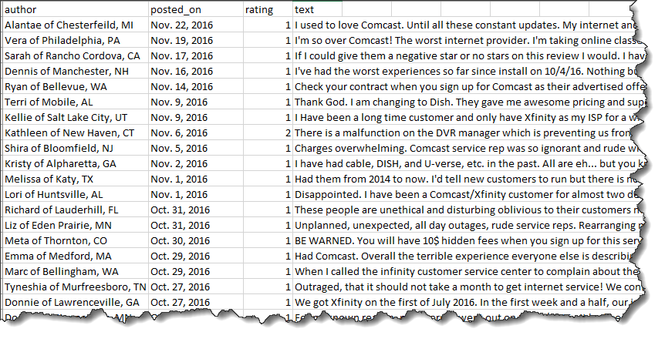
Available data of Comcast complaints (5600+) reduced to remove missing values
It consist of the following fields:
Author (first name, city and state)
Posted_on date
Rating (0 to 5)
Complaint text

Slide 3
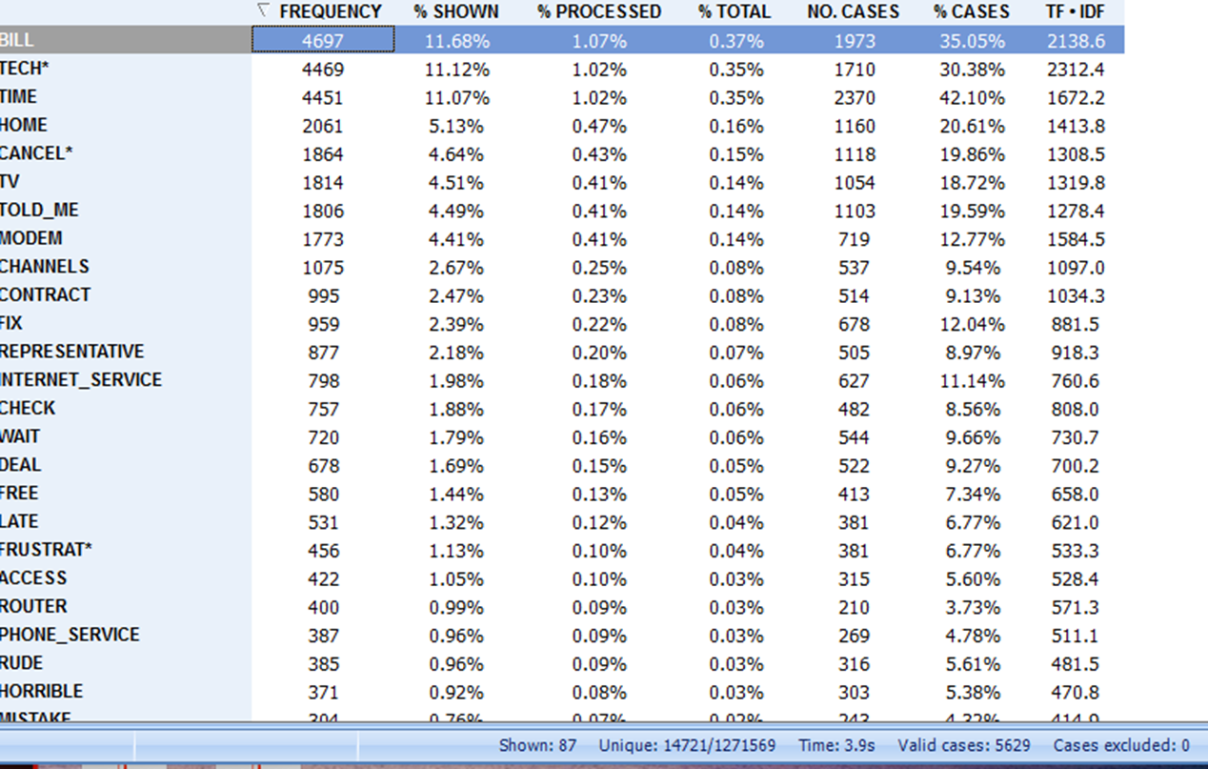
Text Analytics Breaks Statements Down To Unique Words
The Word “Cancel” and Its Variants are Identified as Interesting Labels for Prediction of Churn

Slide 4
Predicting Churn using text analytics
Approximately 19.65% or 1/5th of the complaints contains a term from the word cloud cancel*(cancel, switching, termination, etc.), indicative of “customer churn”
In order to avoid churn, it would be useful to accurately predict the reasons for “churn” and improvement areas to avoid “churn”

Slide 5
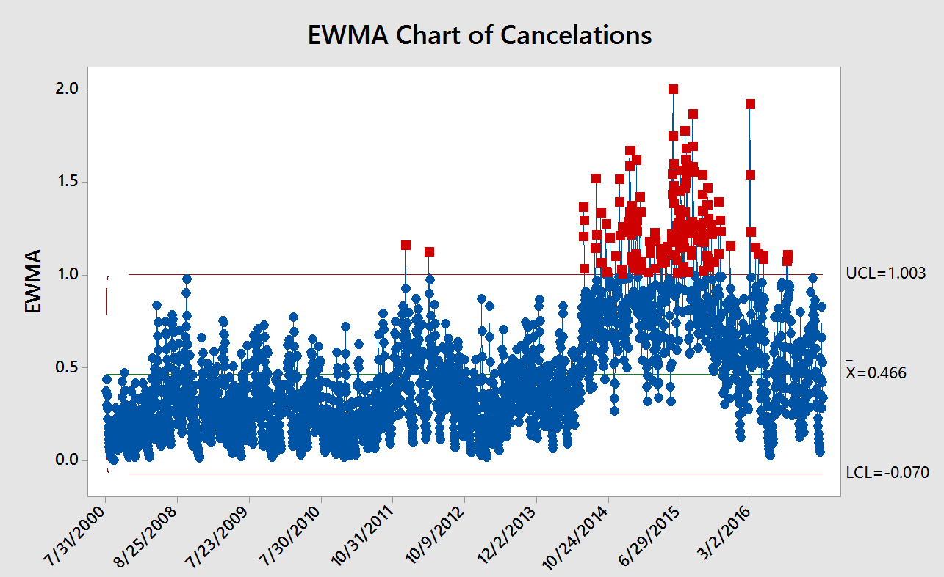
Insight : The frequency of occurrence of the term Cancel* has been
sporadically increasing since Dec-2007, as is evident from the above chart .
Minitab Graph

Slide 6
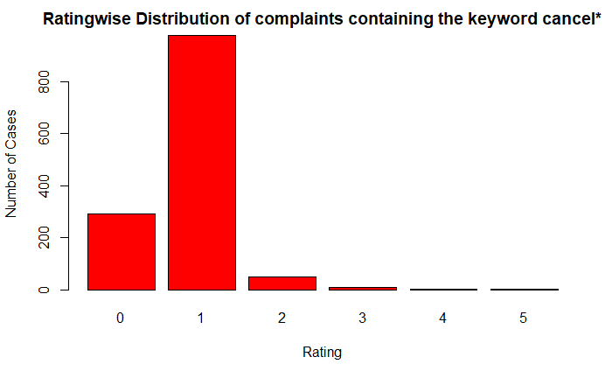
Ratingwise distribution of complaints containing “cancel”
Insight: Most Customers wishing to cancel services gave a low rating of 1 or 0.

Slide 7
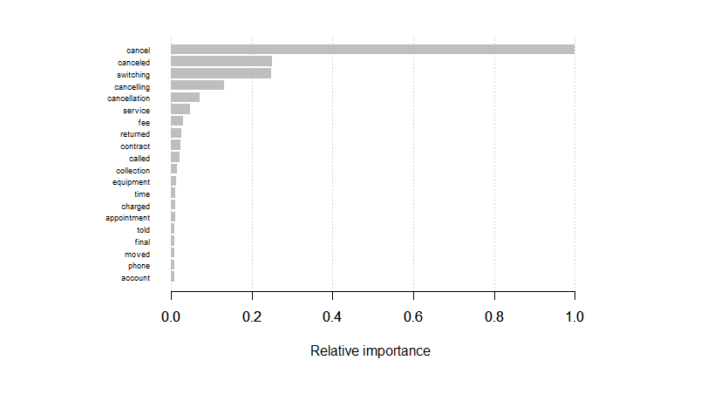
Most Important business parameters identified by predictive modelling

Slide 8
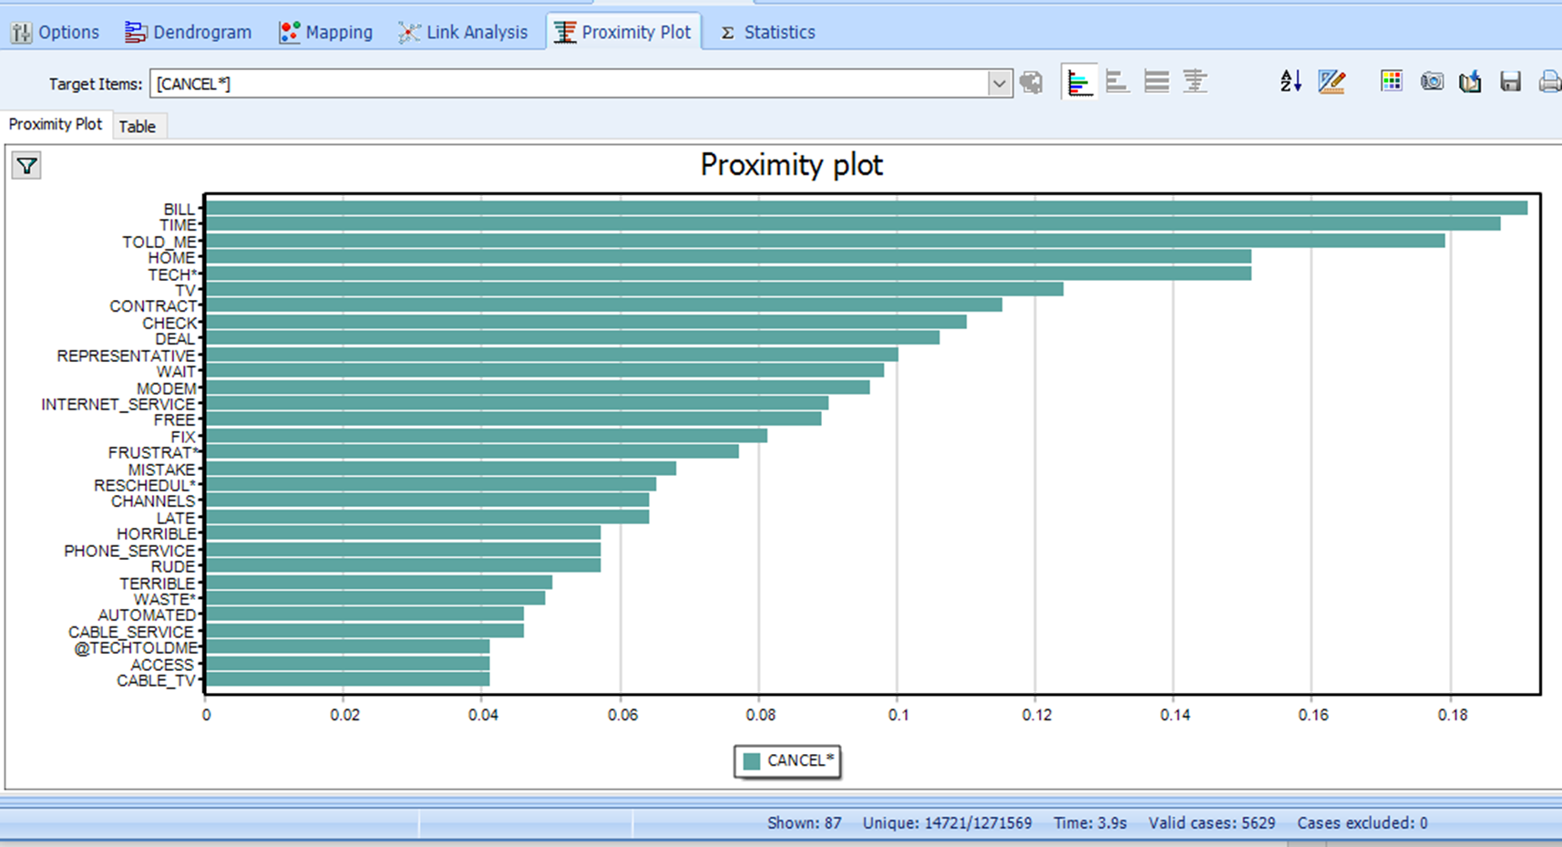
Word Proximity to “Cancel”

Slide 9
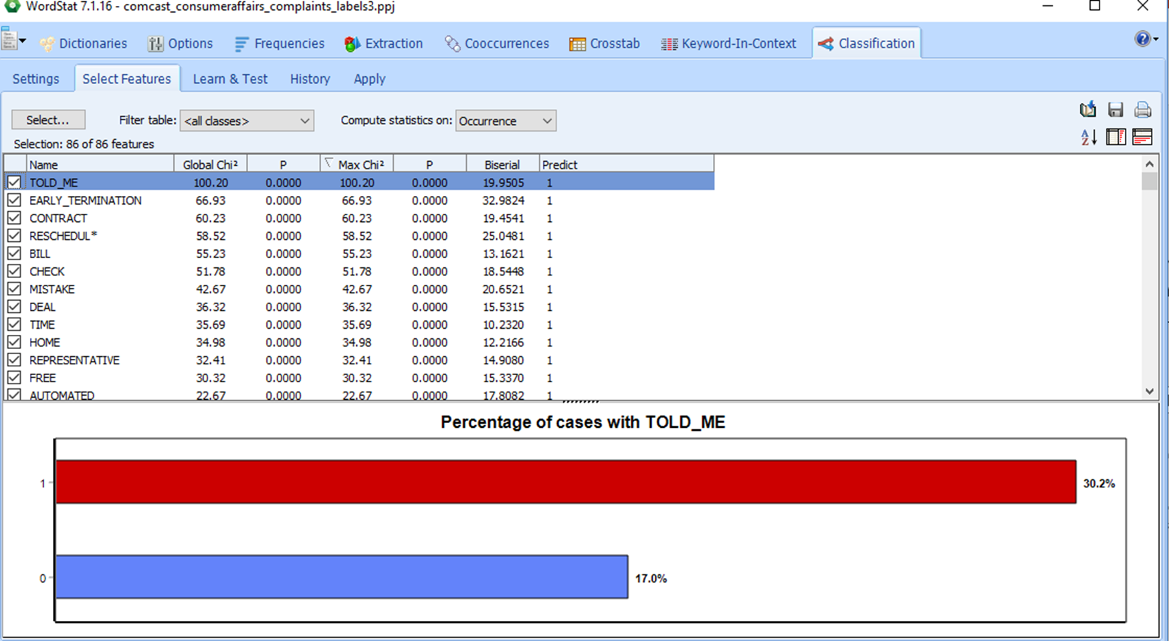
Identifying Potential Predictor Words and Phrases to “Cancel”
Using Machine Learning

Slide 10
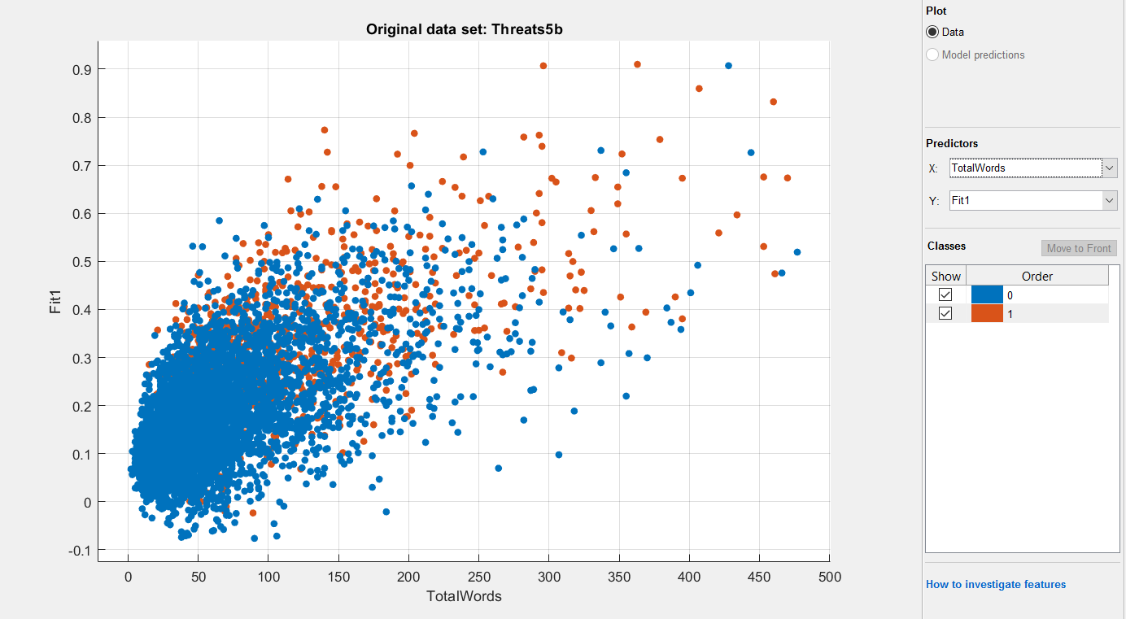

Slide 11
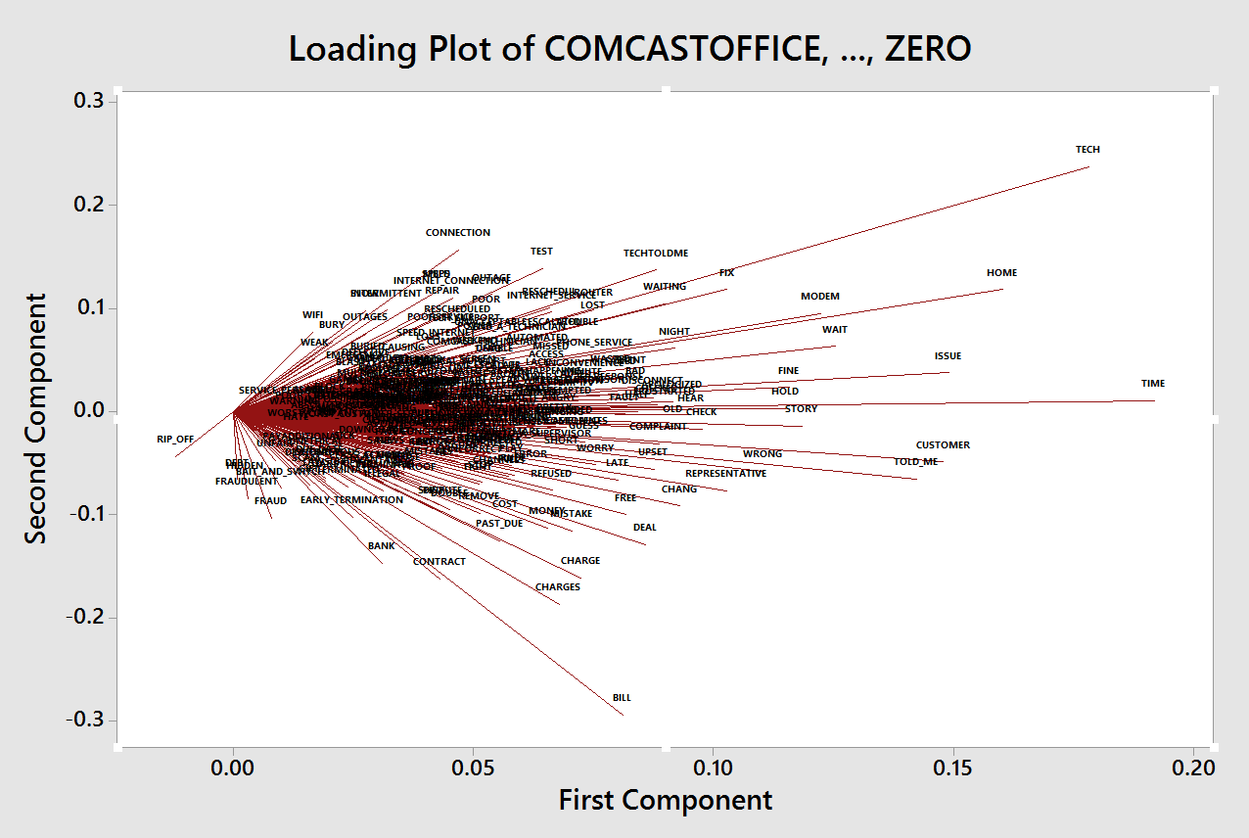
Topic Modeling
Minitab Principle Components

Slide 12
Dissatisfaction with Product Performance
Dissatisfaction with Service Personnel/Visit
Fraud
Dissatisfaction with Billing and Business Conduct

Slide 13
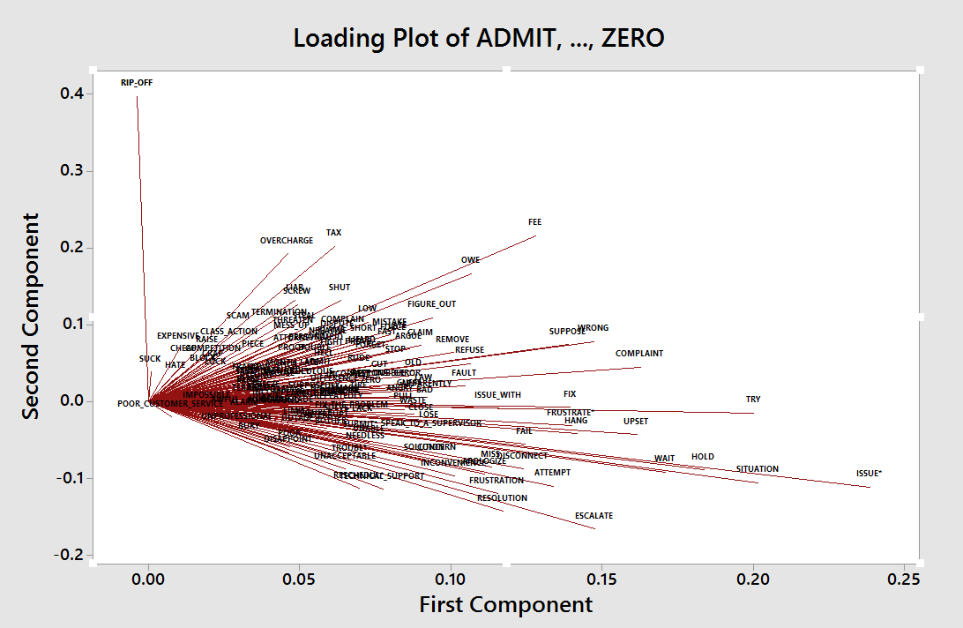
Filtered for Sentences Containing the Word “Issue”

Slide 14
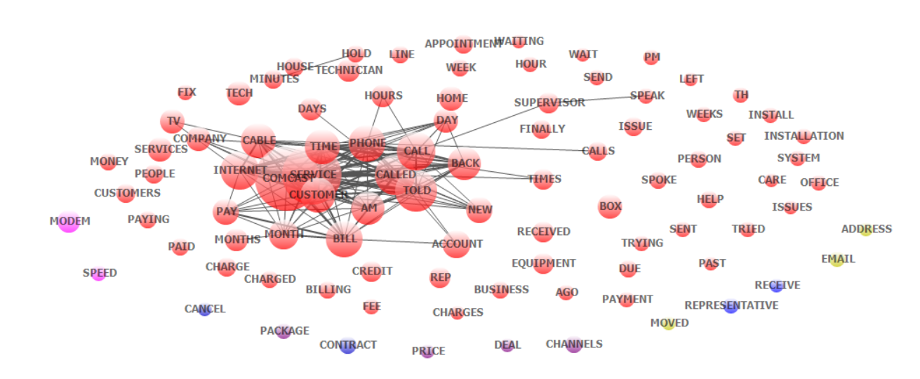
Wordstat Multi-Dimensional Scaling

Slide 15
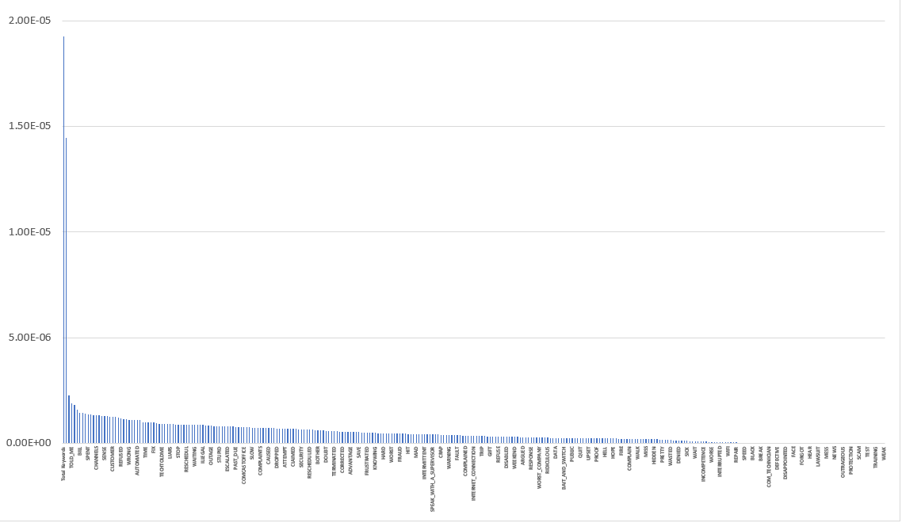
Word Importance As a Predictor of Comcast Cancelations
Using Gradient Boosting
Relative Importance
Sum of Keyword Count
Total Word Count

Slide 16
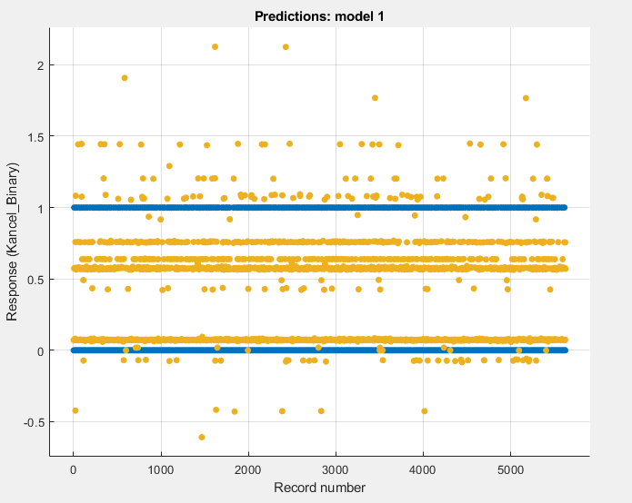
MATLAB
Will Cancel Service
Threshold
Will Keep Service

Slide 17
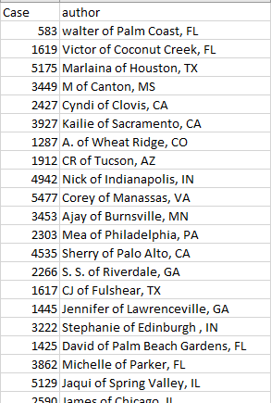
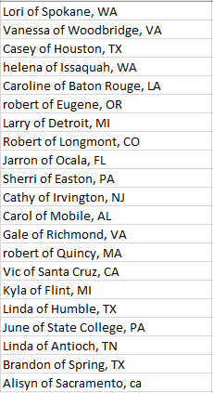
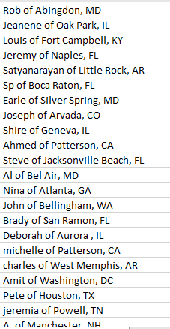
The Predictive Model Identifies Targets For a Risk Management Strategy for Comcast
Customer Nearly Certain to Cancel
Customers Highly Likely to Cancel
1,274 Probable to Cancel
To 114 total
To 52 total
To 1274 total

Slide 18
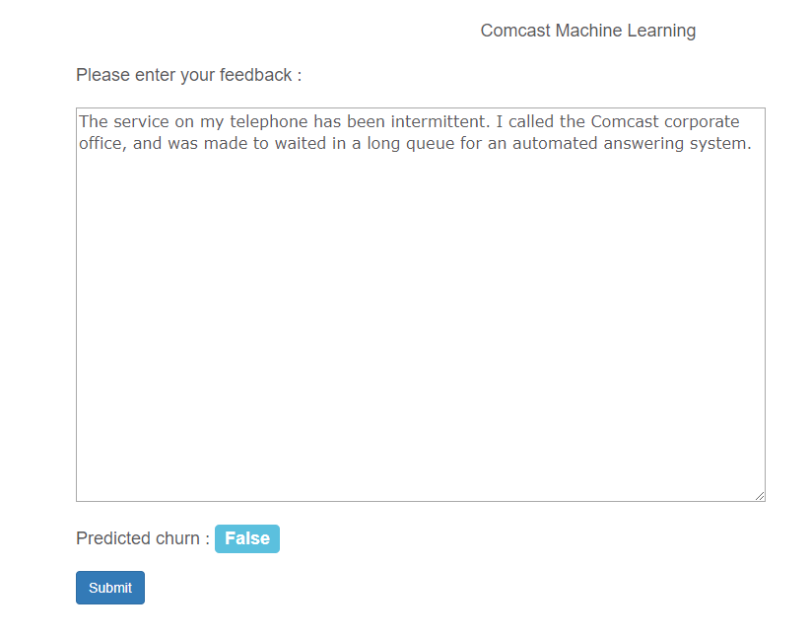
Production Prototype Based Upon Machine Learning Naïve Bayes
Predicts Customer Will Not Cancel

Slide 19
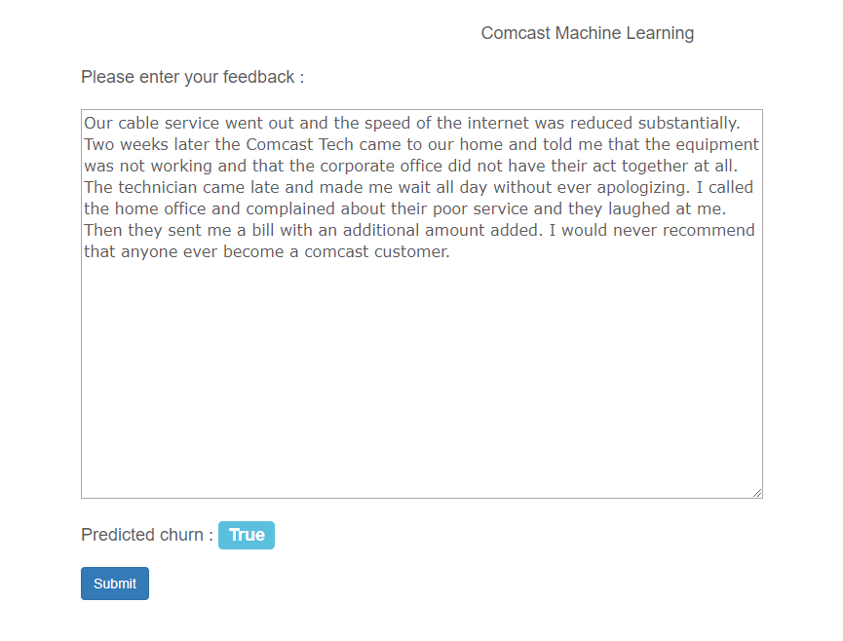
Production Prototype Based Upon Machine Learning
Predicts Customer Will Cancel

